Slide 1

Modellazione 3D: verso una fruizione meta-reale del Patrimonio
M. De Bari - N. Barbuti
EADH 2021
Krasnoyarsk, Russia – 21-25 September 2021
Krasnoyarsk, 24 September 2021
mauro.debari@uniba.it; nicola.barbuti@uniba.it

Slide 2
State-of-the-Art
Recently, the cultural scenario has shown the need for renewal.
In the Era of Digital Transformation (DT), digital gets an excellent potential to invest in.
This trend increased during the COVID-19 pandemic. Cultural institutions have wondered how to make their assets accessible to an absent public.
Krasnoyarsk, 24 September 2021
mauro.debari@uniba.it; nicola.barbuti@uniba.it

Slide 3
Cultural Institutions: The Museum system
Good practices: Vicoria & Albert Museum
The necessity to renew
Cultural Insititutions have tried to change
Covid-19 has accelerated the necessity
Museums:
.user -> touch-free experience
Among cultural institutions, some museums have tried to experiment with pioneering experiences by taking an interest in the user.
The Victoria & Albert Museum is among the first to aim for a touch-free approach.
https://www.vam.ac.uk/, (last consulted: 13/09/2021).
Krasnoyarsk, 24 September 2021
mauro.debari@uniba.it; nicola.barbuti@uniba.it

Slide 4
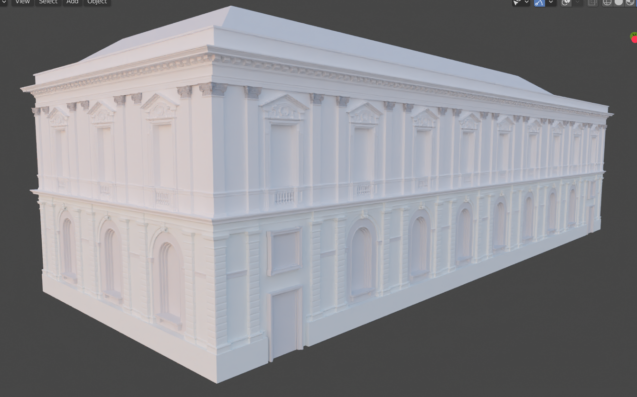
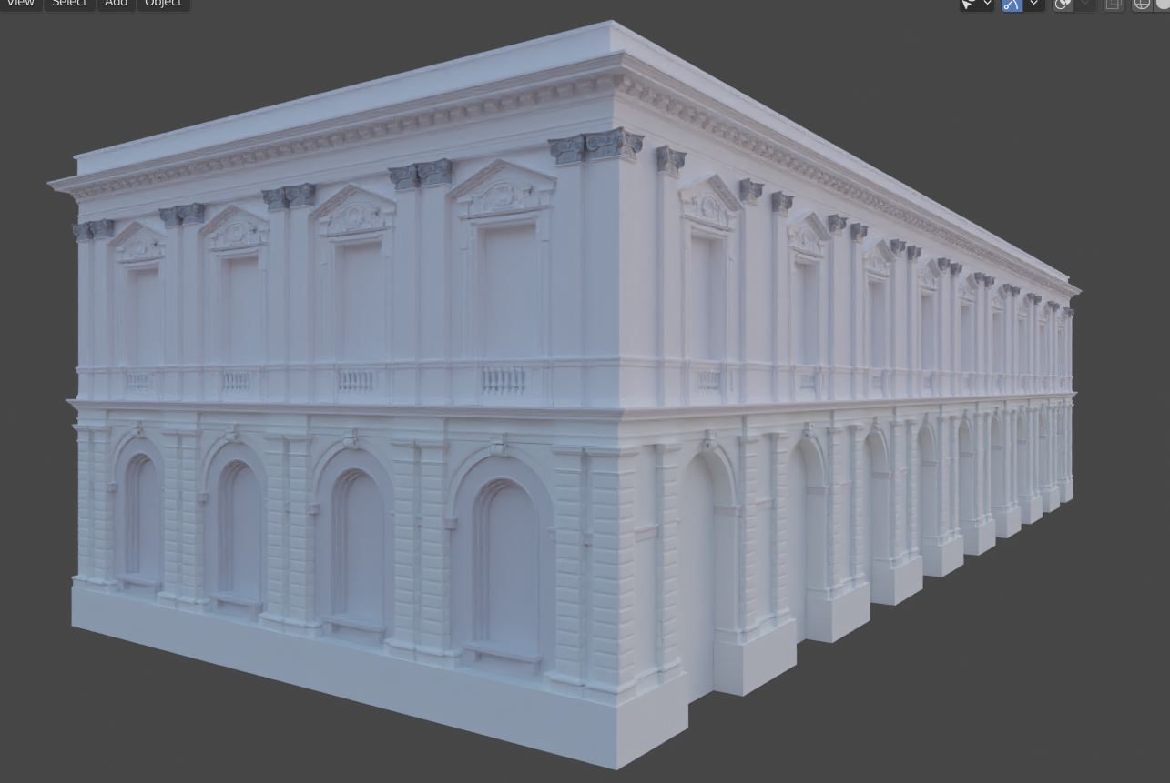
Cultural Institutions: The Museum system
An excellent tool for creating relevant experiences remains 3D. But how to make 3D interactive and user-centric? The simple visual reconstruction of the cultural resource is no longer enough.
3D visual reconstruction: Ex-Mercato del Pesce, Bari
Krasnoyarsk, 24 September 2021
mauro.debari@uniba.it; nicola.barbuti@uniba.it

Slide 5
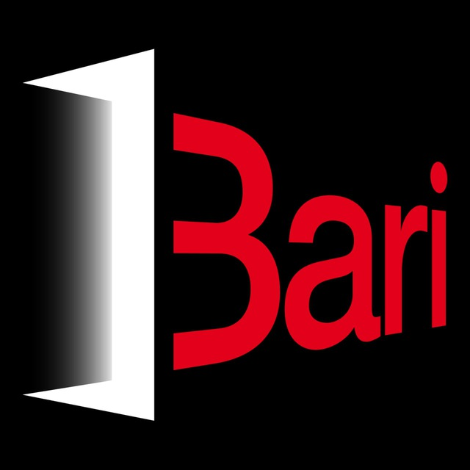
Case study: iBari
The possibility of experimenting with innovative perspectives is the assumption that guided the iBari project, created by a public-private consortium¹ between 2019 and 2021 as part of calls for innovative research and development activities funded by the Apulia region.
The project aims to enhance Piazza del Ferrarese and the Petruzzelli Theater, symbolic monuments of the city of Bari. Innovative Immersive Reality (IR) and Augmented Reality solutions have meshed with the 3D visual reconstruction of monuments. In particular, it is analyzed the use of 3D and AR on Piazza del Ferrarese: Ex Mercato del Pesce.
¹Composed by:
DISUM Department of Humanities, University of Bari Aldo Moro, https://www.uniba.it/ricerca/dipartimenti/disum, (last consulted: 13/09/2021);
THESIS S.r.l., http://www.thesisnet.it, (last consulted:13/09/2021);
Quorum Italia S.r.l., https://www.amministrazionicomunali.it/puglia/bari/quorum-italia-srl, (last consulted: 13/09/2021);
DABIMUS S.r.l., https://www.dabimus.com/, (last consulted: 13/09/2021).
Krasnoyarsk, 24 September 2021
mauro.debari@uniba.it; nicola.barbuti@uniba.it

Slide 6
Cultural Institutions: the necessity of interdisciplinarity
Interactive and user-centred experiences require cooperation on different levels, in which different knowledge must be combined. In the iBari project, different competencies were involved: historians, architects, technicians, developers co-worked simultaneously. In this context, the «fil rouge» was offered by the digital.
Krasnoyarsk, 24 September 2021
mauro.debari@uniba.it; nicola.barbuti@uniba.it

Slide 7
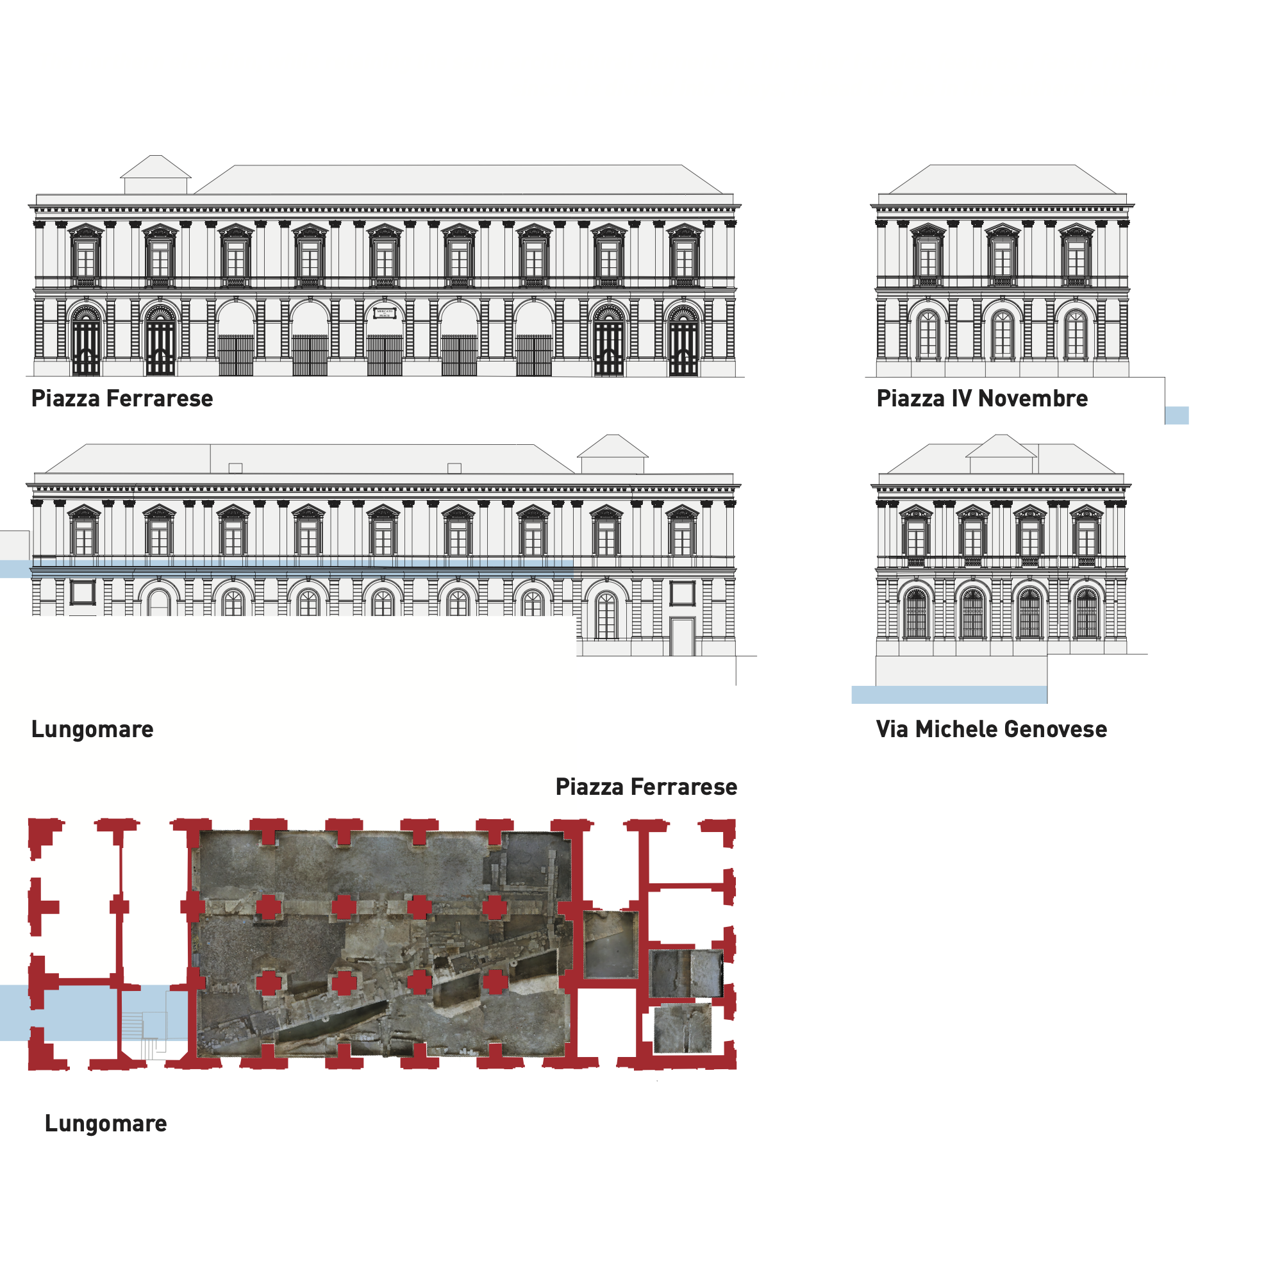
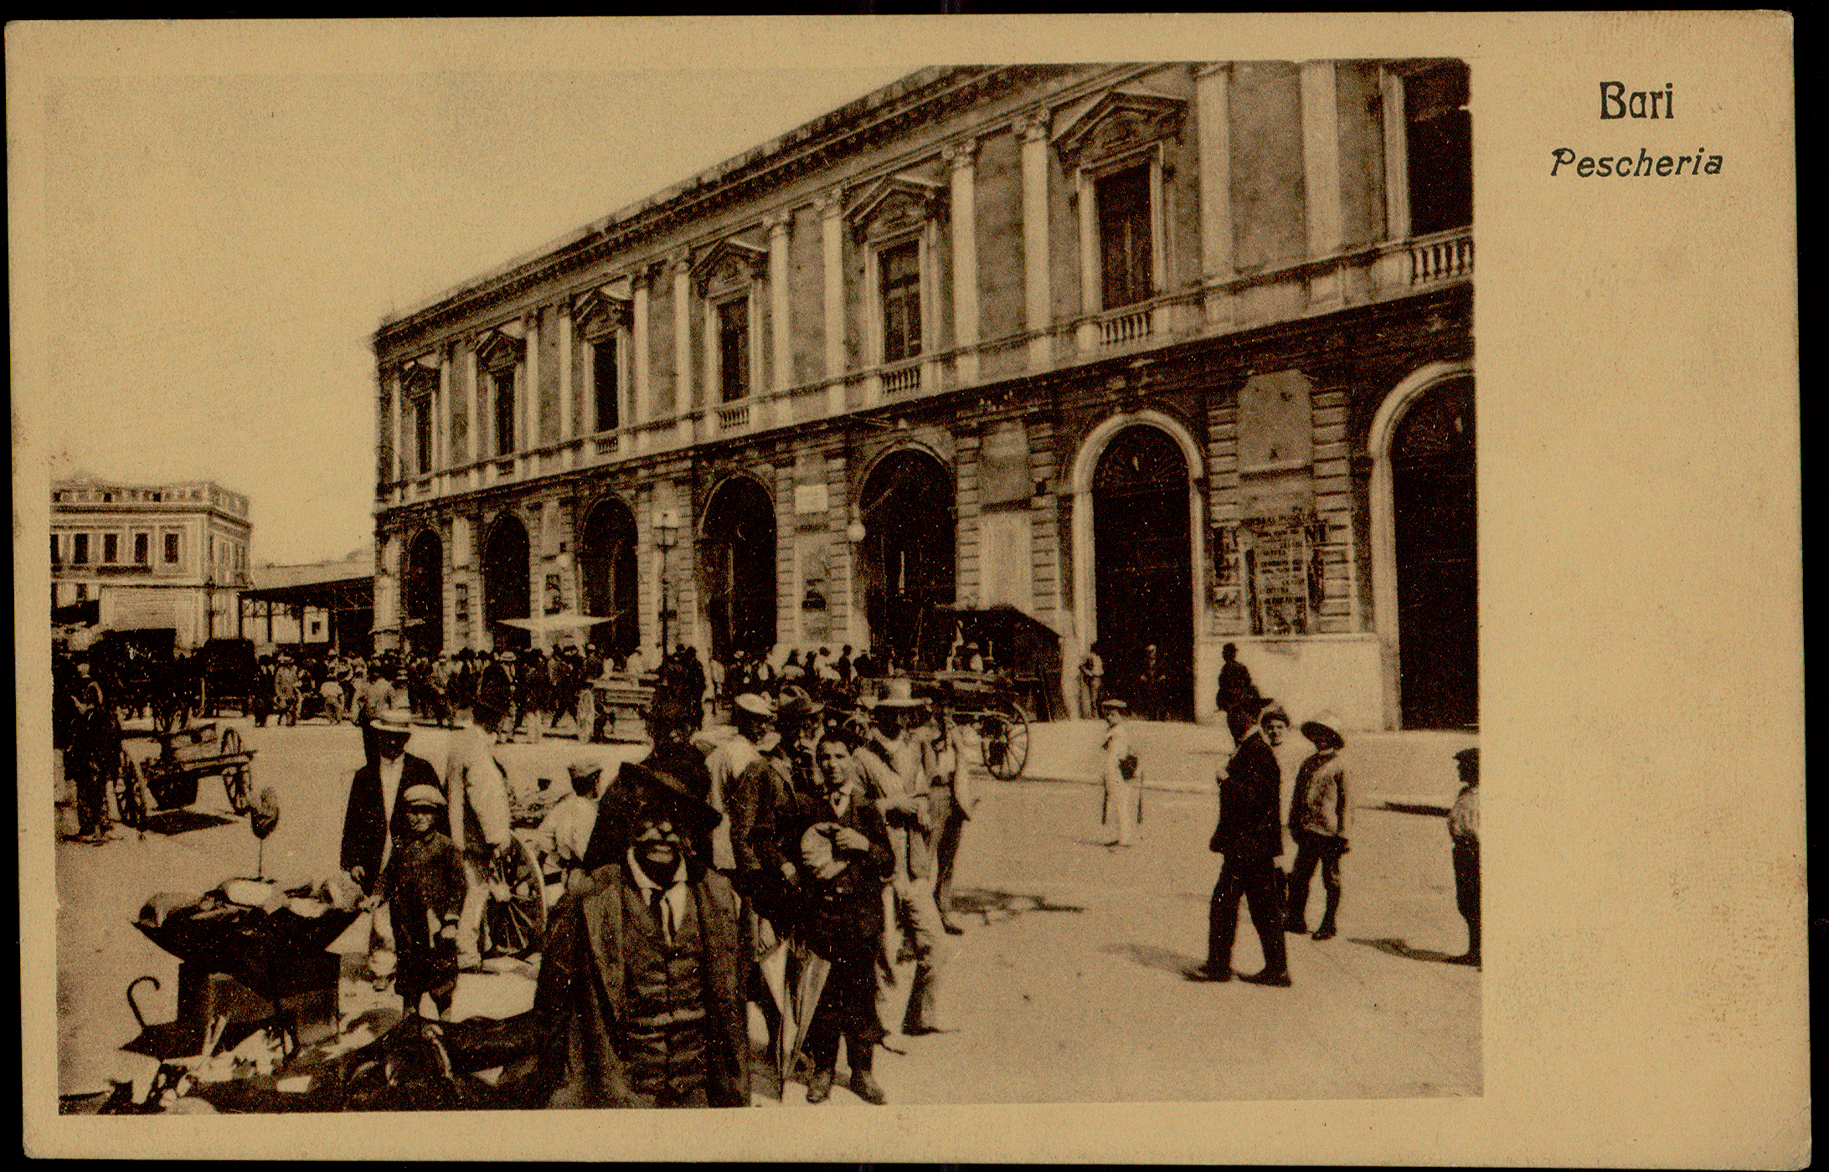
Process:
Firstly, primary and secondary historical sources, (both textual and iconographic: photographs, postcards, etc.) and techniques (floor plans, etc.) were recovered to reconstruct the life cycle of the building. It was thus possible to identify six different periods, corresponding to as many infrastructural and use changes of the monument.
Planimentry of the building
Vintage postcard of Piazza del Ferrarese with detail on the building of the EX Mercato del Pesce (private collection).
Krasnoyarsk, 24 September 2021
mauro.debari@uniba.it; nicola.barbuti@uniba.it

Slide 8
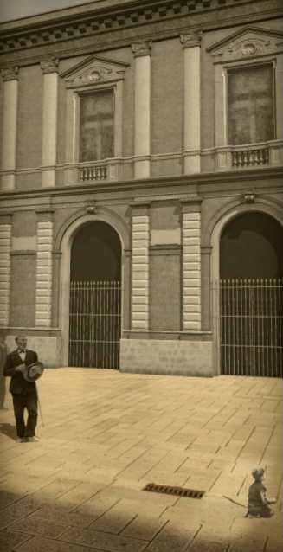
The second step was dedicated to choose and select the postcards and photos for rendering the digital models, each symbol of a period. Then, the artefacts were scanned in high definition with professional planetary scanners.
Digital images were processed with graphic design software to create the textures applied to the digital model.
At the same time, using the open-source software Blender the main building of each period was digitally reconstructed in 3D.
The last step was the application of each digital 3D representation of the textures related to each phase of the architectural evolution.
Patricular of the building with textures created from old photos
Krasnoyarsk, 24 September 2021
mauro.debari@uniba.it; nicola.barbuti@uniba.it

Slide 9
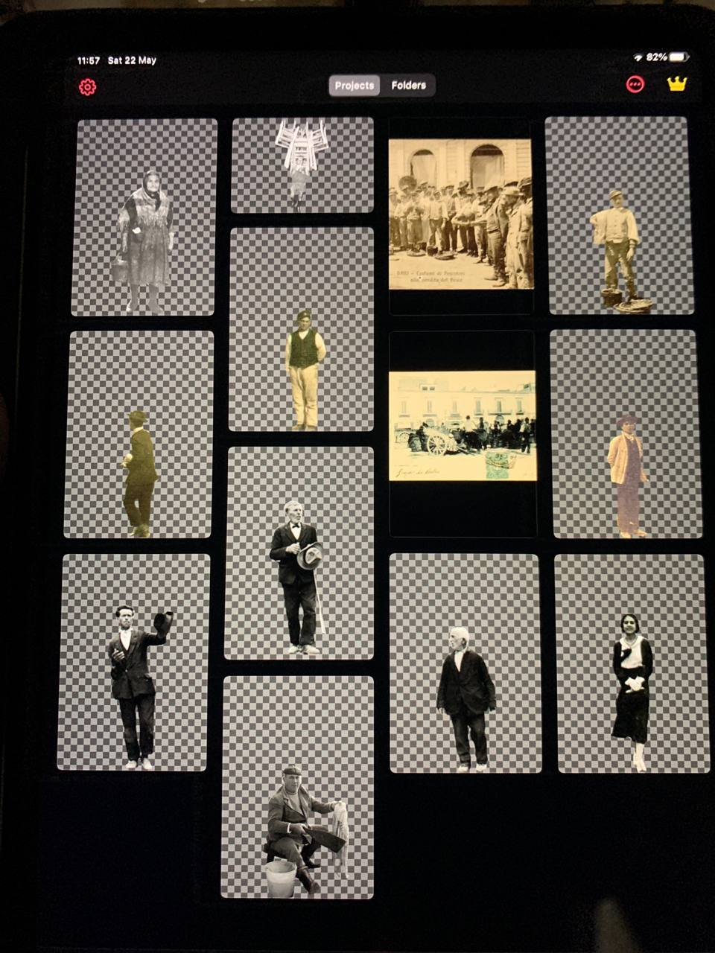
We created some textures from old photos reproducing people in period clothing. Some characters, according to a trend created with the particle system technique, move in the scenario. We processed some textures with animation tools(Avatarify) and linked them to audio storytelling in the ancient idiom of Bari. We are also translating the audio in multilingual to expand the user experience keeping his interaction with the city history.
Characters used in the project
Krasnoyarsk, 24 September 2021
mauro.debari@uniba.it; nicola.barbuti@uniba.it

Slide 10
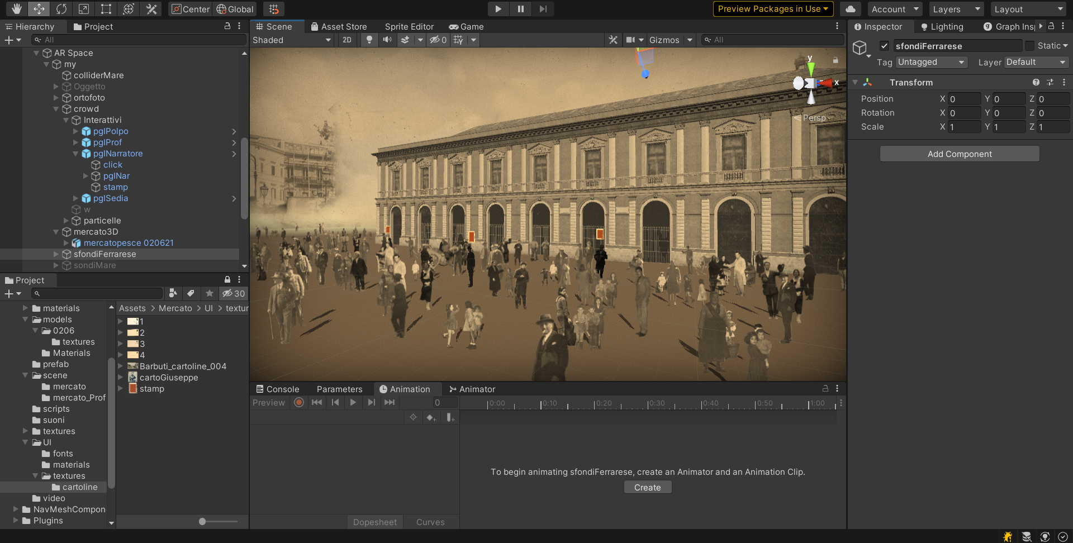
Finally, we integrated the digital models in an app created using Unity software. Each model represents a Region of Interest (RoI) to foster the interaction of the users with the AR reconstruction. As a result, the user, positioning himself in front of the monument and downloading the app on his device, can view the building in real-time and, at the same time, can interact with the «people». They perform basic movements, if animated, are marked with markup through which to access the connected multimedia contents. By typing on the marking, the user can listen to storytelling in the local dialect, read narrative textual contents of the monument, discover ancient crafts that are now lost.
iBari project- Unity app
Krasnoyarsk, 24 September 2021
mauro.debari@uniba.it; nicola.barbuti@uniba.it

Slide 11
The project evolves the concept of 'digital entity’ expanding it into a 'meta-real museum representation. A process that, can generate 'n' applications if taken to other multiple cultural contexts.
Krasnoyarsk, 24 September 2021
mauro.debari@uniba.it; nicola.barbuti@uniba.it

Slide 12
Thanks!
Mauro De Bari – Nicola Barbuti
Krasnoyarsk, 24 September 2021
mauro.debari@uniba.it; nicola.barbuti@uniba.it

